Slide 1

Building Rule-Based OLTP Systems Using Oracle RDF
Dr. Philip Cannata and Nigel Jacobs
Let’s Put the Application Complexity in the Database!

Slide 2
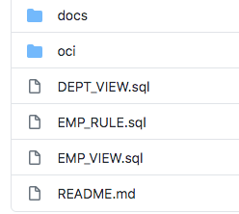
Building Rule-Based OLTP Systems Using Oracle RDF
Links to the git repositories referenced in this presentation are in the Slack channel
https://github.com/CannataUT/RDF-OLTP
https://github.com/CannataUT/MS-RDBMS
Question can be addressed to: phil.cannata@oracle.com and nigel.jacobs@oracle.com

Slide 3
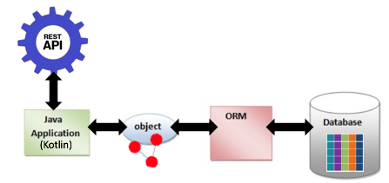
Conventional Way to Think about Building OLTP (SaaS) Systems Today

Slide 4
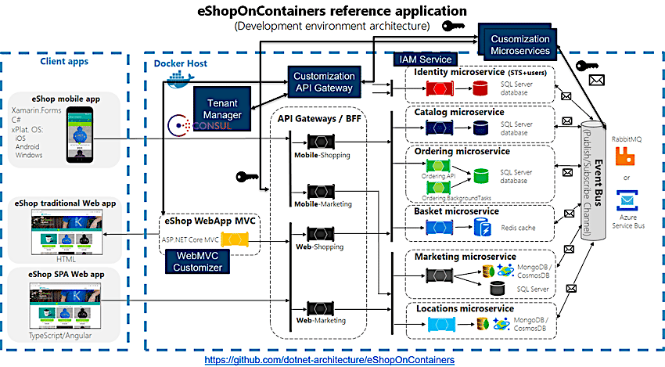
This is Typically Cast as a Set of Microservices
Setup microservice
Keys microservice
Work Flow microservice
Inspection microservice
Billing microservice

Slide 5
Let’s Turn This Way of Thinking Upside Down

Slide 6
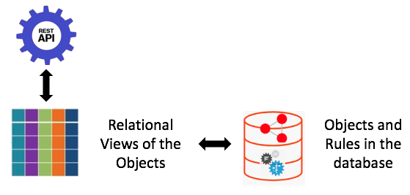
Building Rule-Based OLTP (SaaS) Systems Using Oracle RDF
(RDF-OLTP)

Slide 7
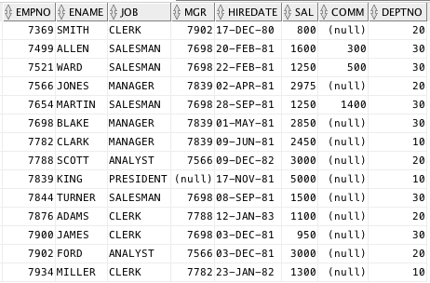
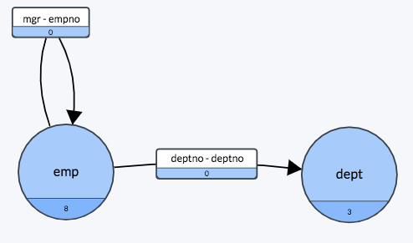
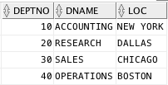
This Approach Will be Demonstrated Using a Simple Example Based on the Familiar Emp/Dept Schema

Slide 8
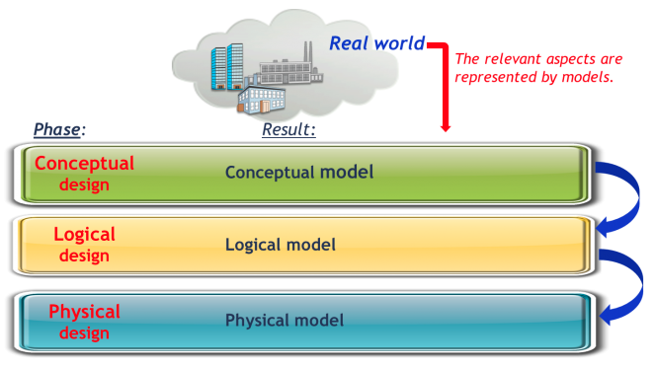

Traditionally, the Database for this Example Would be Built as Follows:
Each time something changes, you get to do this all over again.

Slide 9
Then You Would Build Your Application as a Bunch of Java Code On Top of the Database

Slide 10
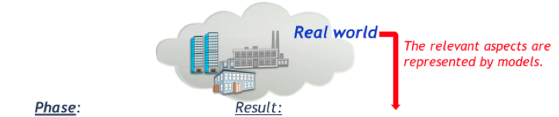

With RDF-OLTP, You do the Following to Build the Database:
I.e., You don’t Actually Build the Database because RDF is Schemaless
If something changes, you just change the View. No change is needed in the database.

Slide 11
Instead, You Build Relational Views on the Conceptual Model
Then Build INSERT, UPDATE, and DELETE Triggers on These Views
(In Principle, the Views and Triggers could be generated based on a simple declarative set of specifications based on the Conceptual Model, i.e., this is a Low Code Model of Development)
The RDF Database is Created When You Insert Data Into It

Slide 12
Then You Build Application in the Database as a Set of Rules

Slide 13
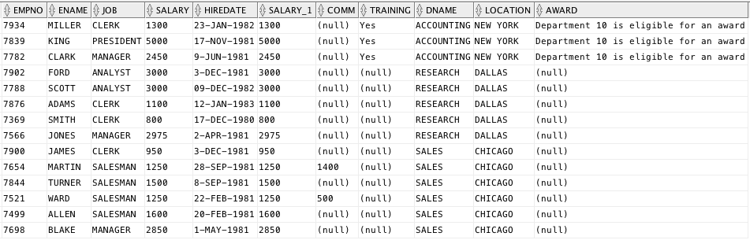
Here’s an Example Application:
“If all of the employees in a department have taken a training course, the department is eligible for an award”

Slide 14
Here’s the Application Code in the Database as a Rule:
INSERT { ?dept_uri saas:award ?eligible . }
WHERE
{ # Get the dept for each emp.
?emp_uri a saas:Emp .
?emp_uri saas:empDeptEVA ?dept_uri .
?dept_uri saas:deptno ?deptno .
MINUS # Remove depts that have at lease one emp who is not trained.
{ SELECT ?dept_uri
WHERE
{
?emp_uri a saas:Emp .
?emp_uri saas:empDeptEVA ?dept_uri .
OPTIONAL { ?emp_uri saas:training ?training. }
FILTER(?training = "")
}
}
# Construct the value to be inserted into the dept’s award attribute.
BIND(CONCAT("Department ", ?deptno, " is eligible for an award") AS ?eligible)
}
Get a list of all departments that have employees.
Take a Deparment out of the List if an employee has not taken the training.
Create the desired insert value.

Slide 15
Oracle’s Implementation of RDF Has Some Unique Features That Allows These Rules Based Applications to be Built on an Enterprise Level
Tight integration of SQL and RDF/SPARQL
Integrates seamlessly with ORDS (Oracle REST Data Service)
Built in Data Partitioning
PDBs
All OCI Services are available to the application, e.g.,
telemetry, events, health services . . .
No “Provisioning” is needed other than compiling views in the PDB
Very little DBA Assistance is needed
There is a Current OCI SaaS Customer That is Using All of This to Deploy a Very Successful Mutlitenant, Production Application.

Slide 16
Here’s the Same Application as a Microservice:

Slide 17
A ‘Traditional’ Microservice Approach to EmpDept (MS-RDBMS)
Complex mix of mature and emerging technologies
Helidon - microservice framework
Java
ADF
JDBC/SQL
Oracle 12c RDBMS

Slide 18
Architectural Layers within the Microservice
REST API
Business Logic
ORM
RDBMS

Slide 19
REST API
HTTP / JSON ↔ Java APIs / POJO Domain Objects
List all employees as a list of JSON maps:
curl -X “GET http://localhost:8080/Emp”
Get a single employee given the employee name, as a JSON map:
curl -X “GET http://localhost:8080/Emp/name=Nigel%20Jacobs”
Create an employee:
curl -X “PUT http://localhost:8080/Emp/name=Nigel%20Jacobs&salary=123...”
Routing, error handling, serialization

Slide 20
Business Logic
High level actions on business types (repositories)
Business semantics
Java / POJOs
Pass-through: majority of logic pulled down into ORM

Slide 21
Business Logic
EmployeeRepository:
public Employee find(Integer employeeNumber) // find an employee by emp no
public Collection<Employee> loadAllEmployees() // load all employees
DepartmentRepository:
public void save(Department department) // save department

Slide 22
Object Relational Mapper (ORM)
ADF entities and mapping: EOs, AMs, Vos
Built extended from DB schema via Jdev UI at design time
Generated Java stubs, XML files
POJO ↔ JDBC/SQL serialization
Caching to reduce DB hits

Slide 23
Object Relational Mapper (ORM)
Employee
EO
Employee
VO
Emp
EmpDept
AM
EmptDept
VO
Employee
EO
Department
VO
Dept

Slide 24
Object Relational Mapper (ORM)
public class EmpDeptAMImpl extends OAApplicationModuleImpl {
/**
* Find a specific employee, by employee number
*/
public Employee findEmployee(Integer empNo) {
CachedMapper mapper = new CachedMapper();
loadEmployeesIntoCache(empNo, mapper);
Integer deptNo = mapper.getDeptNo(empNo);
if (deptNo != null) {
// if employee has a dept, load it's data
loadDepartmentsIntoCache(deptNo, mapper);
}
mapper.finalize(); // apply business logic
return mapper.getEmployee(empNo);
} ...

Slide 25
Object Relational Mapper (ORM)
private void loadEmployeesIntoCache(Integer empNo, CachedMapper mapper) {
EmpDeptVOImpl vo = getEmpDeptVO();
RowSet rs = vo.getDefaultRowSet();
if (empNo != null) {
// apply 'EMP_NO = empNo' filter
ViewCriteria vc = vo.getViewCriteria(EmpDeptVORowImpl.VC_SpecifyEmpVC);
rs.ensureVariableManager().setVariableValue(EmpDeptVORowImpl.VAR_Empno, empNo);
vo.appendViewCriteria(vc);
}
// execute query
String q = vo.getQuery();
AppsLogger.write(this, "Query: " + q, AppsLogger.FINE);
vo.executeQuery();
// read row data from query into mapper
mapper.readRowDataIntoCache(vo);
}

Slide 26
Object Relational Mapper (ORM)
/**
* Pull just employee data through cache
*
* @param row
* @return
*/
private Employee pullEmpDataThroughCache(EmpDeptVORowImpl row, Integer empNo) {
// pull employee from cache
Employee emp = mapEmpNoToEmployee.get(empNo);
// if not in cache, map and put into cache
if (emp == null) {
// map to domain object
emp = mapToEmployee(row);
// put in cache
mapEmpNoToEmployee.put(empNo, emp);
}
return emp;
}

Slide 27
Object Relational Mapper (ORM)
/**
* Map to employee domain object
* @return
*/
private Employee mapToEmployee(EmpDeptVORowImpl row) {
Employee employee = new Employee();
employee.setEmployeeNo(row.getEmpno());
employee.setName(row.getEname());
employee.setJob(row.getJob());
employee.setManager(row.getMgr());
employee.setHireDate(row.getHiredate());
employee.setSalary(row.getSal());
employee.setComm(row.getComm());
employee.setTraining(row.getTraining() != null && row.getTraining() == 1);
// cache empNo -> employee
mapEmpNoToDeptNo.put(employee.getEmployeeNo(), row.getDeptno());
return employee;
}

Slide 28
Object Relational Mapper (ORM)
public void finalize() {
// materialize the object links: iterate over employees, and for each employee,
// set the department link to the cached department object
for (Integer empNo : mapEmpNoToEmployee.keySet()) {
Integer deptNo = mapEmpNoToDeptNo.get(empNo);
Employee emp = mapEmpNoToEmployee.get(empNo);
Department dept = mapDeptNoToDepartment.get(deptNo);
emp.setDepartment(dept);
}
// For given employee and her department, calculate the department award
// based on the employees training and the departments existing award value
for (Employee emp : mapEmpNoToEmployee.values()) {
Department dept = emp.getDepartment();
boolean training = emp.hasTraining();
// dept has award until at least one employee without training
boolean award = (dept.hasAward() == null) || dept.hasAward();
dept.setAward(award && training);
}
}

Slide 29
Relational DBMS
Oracle 12c
SQL:
SELECT * FROM EMP, DEPT WHERE EMP.DEPTNO = EMP.DEPTNO
DDL / DML:
CREATE TABLE EMP (EMPNO NUMBER(7) NOT NULL,..
Datasource definitions: host/service/user/password

Slide 30
Findings from Microservice Approach
Multiple formalisms and develop tools exponentially slows dev cycle time
Multiple, heterogonous layers increases code complexity
Loose-coupling increase network traffic: 2 DB hits / employee
Multi-tenancy & partitioning: architecture complicates provisioning
Scalability: complicated by architectural complexity

Slide 31
Building Rule-Based OLTP Systems Using Oracle RDF
Summary
Simple Schema Management.
Business Logic is in one place – the database. This is a very “Low Code” solution.
No Java, ORM, XML, Docker, Kubernetes, etc. required.
No “Provisioning” is needed other than compiling views in the PDB. I.e., no need for CI / CD, Jenkins.
Data Partitioning is built-in.
Low DBA overhead required.
All of the Enterprise features of Oracle and OCI are available – PDBs, backup and recovery, high availability, disaster recovery, scheduling, resource management, telemetry, events, health services . . .
The OLTP Database can become the OLAP Database by just adding OWL constructs.
This is an ideal environment for startups. RDF/SPARQL is even familiar to computer science graduates because of their exposer to the Clojure Programming language and Datomic Database on AWS.
And, they don’t have a body of legacy code that they have to maintain and move forward.

